Slide 1
Automatic electrostatic discharge tester.
Viktor Hugo Hersom From

Slide 2
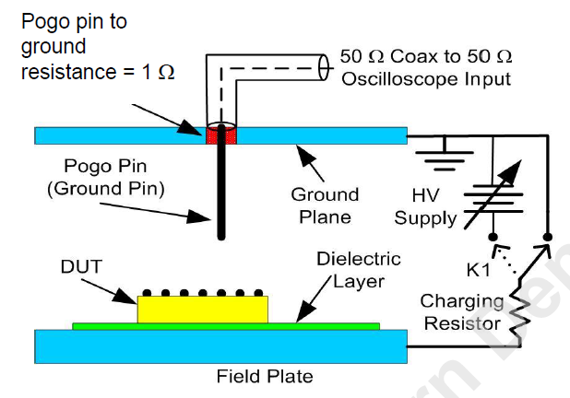
What is the problem?
Electrostatic discharge (ESD) events.
39 – 48% of all product failures in industry related to ESD.
JS-002-2018 test standard.
Used to measure discharge from a device.
Time-consuming to complete.
The most important parts are:
Pogo pin
Ground plane.
Device Under Test (DUT)
Oscilloscope

Slide 3
What is electrostatic discharge?
Triboelectrification.
Electrons are transferred between materials when there is contact.
Charges build up on the two materials.
Electrostatic discharge.
The material between the two charges breaks down.
A conducting path is formed.
Charges move from one component to another.

Slide 4
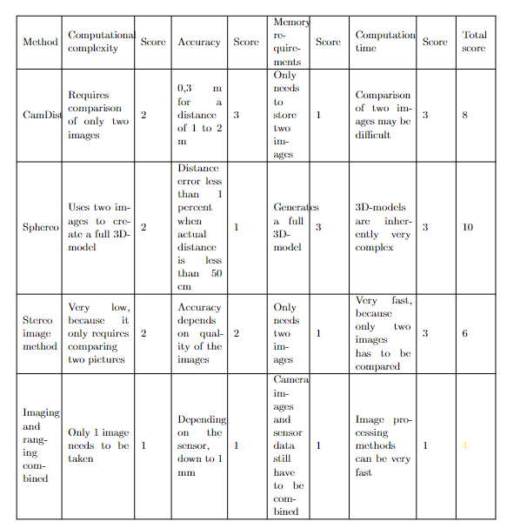
Different concepts for the solution.
CamDist
Sphereo
Stereo image method.
Imaging and ranging combined.

Slide 5
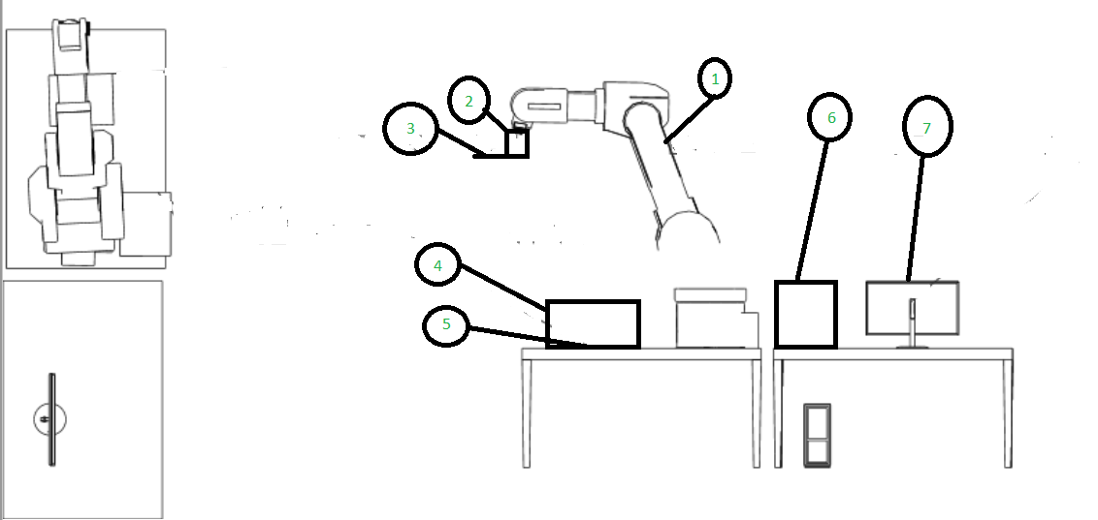
The concept.
A Kawasaki robot arm
A holder consisting of three parts:
Robot tool strut.
Ground plate.
Sensor mount.
A distance sensor and a camera.
A box designed to eliminate shadows.
The Device Under Test (DUT)
An oscilloscope.
A computer used to control everything.

Slide 6
The holder.
The holder is designed to accommodate:
A ground plate.
10 1-ohm resistors.
A pogo pin.
A distance sensor and camera.
The holder consists of three parts:
A robot tool strut.
A ground plate.
A sensor mount.

Slide 7
Hardware.
See3 Cam 130.
VL53L4CD distance sensor.
Force-sensitive resistor.
Oscilloscope.

Slide 8
See3 Cam 130

Slide 9
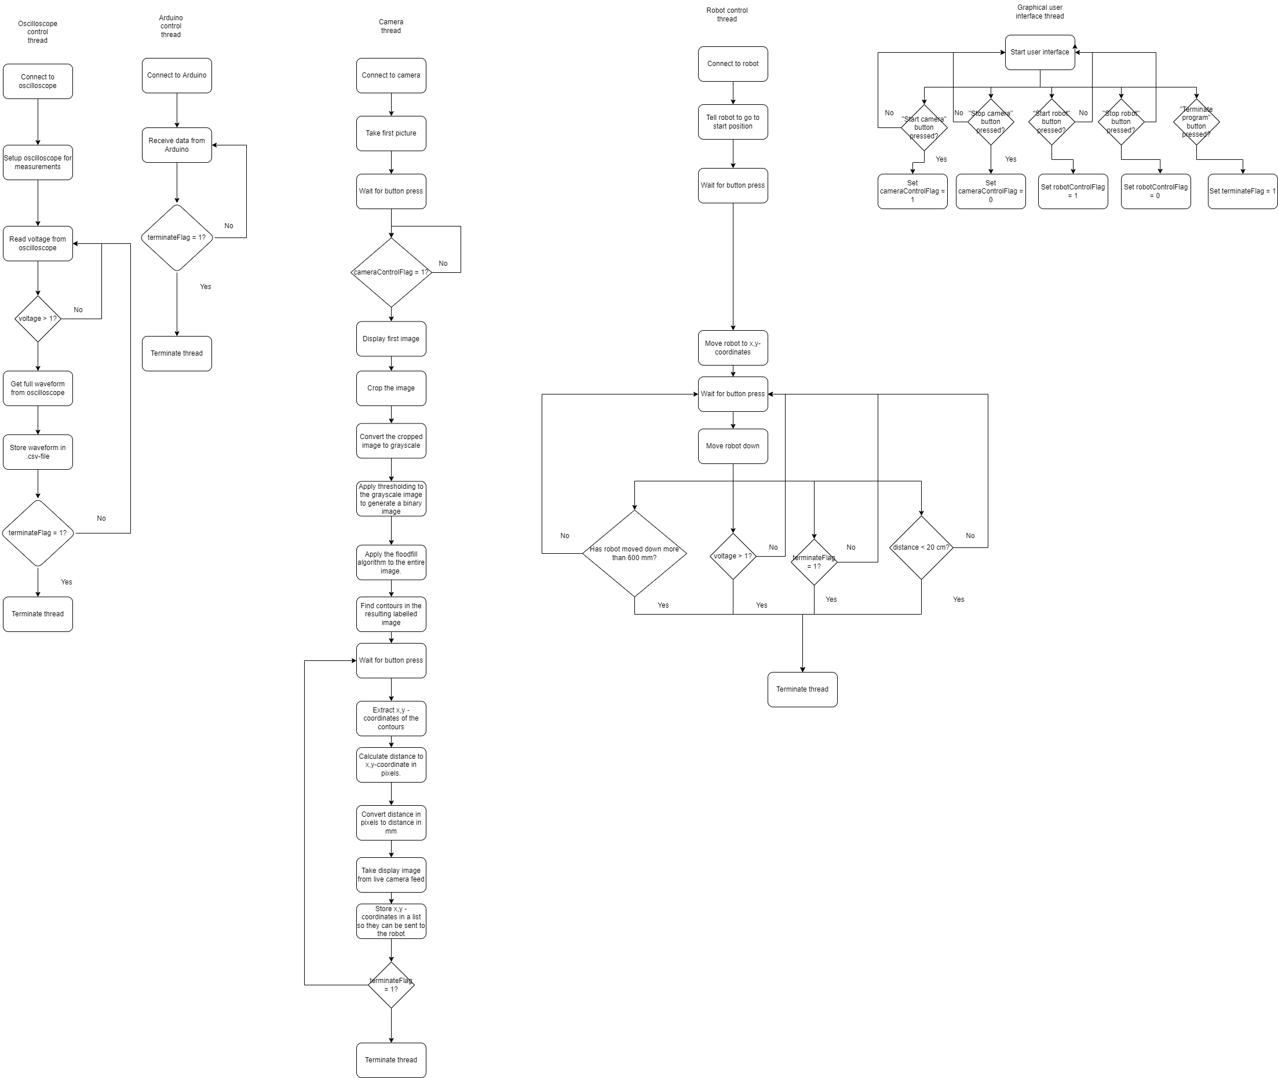
The software concept.
Five threads:
Oscilloscope.
Arduino.
Robot control.
Video.
Interface.
The most important threads are:
Video
Robot control

Slide 10
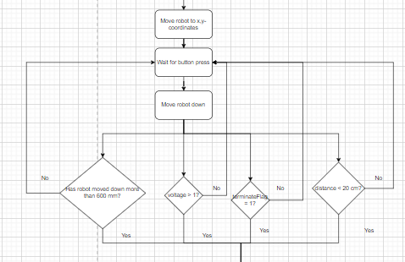
Robot control
Steps:
Move robot to x,y-coordinates.
Wait for button press.
Move robot down.
Stop the robot if:
Robot has moved down more than 600 mm.
The measured voltage is above 1 V.
TerminateFlag is set to 1.
The measured distance is below 20 mm.

Slide 11
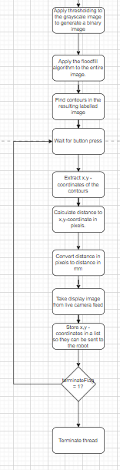
Video thread
Steps:
Generate a binary image.
Apply floodfill.
Find contours in the resulting image.
Wait for button input.
Extract x,y – coordinates.
Calculate distance to coordinates.
Convert distance to mm.
Send distance to robot.

Slide 12
Image processing
Grayscale.
Thresholding.
Finding contours.
Finding x,y-coordinates.

Slide 13
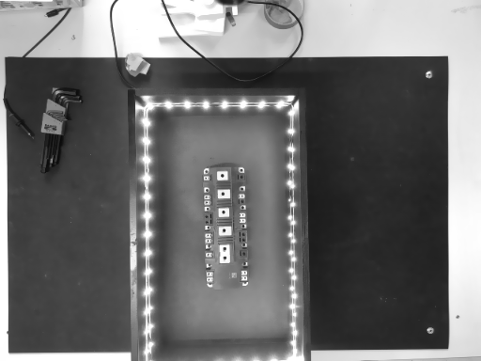
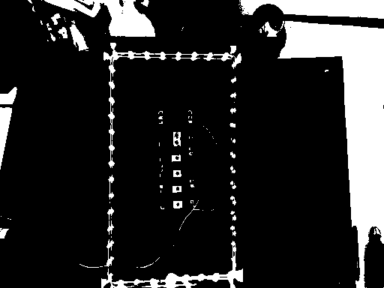
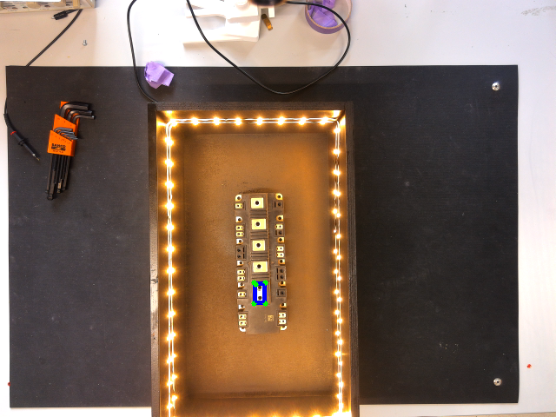
Image processing theory.
Grayscale:
Combine the three color channels into one channel.
Value then represents the intensity of light.
Thresholding:
Convert the grayscale image into a binary image.
If intensity is above a threshold value: 255.
If intensity is below a threshold value: 0.
Finding contours:
findContours()-function from OpenCV.
Extracting x,y-coordinates:
The boxPoints()-function from OpenCV.

Slide 14
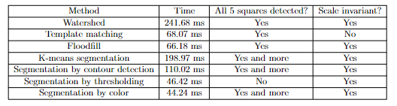
Image segmentation
Possible methods:
Watershed.
K-means segmentation.
Color segmentation.
Contour segmentation.
Template matching.
Floodfill.

Slide 15
Floodfill.
How does it work?
Finding a seed point.
Visit the neighbouring pixels.
Mark them if they are unmarked.
When two neighbouring regions meet:
Note the conflict.
After the entire picture has been marked, resolve the conflict.

Slide 16
Experimental results.
Force-sensitive resistor.
Distance sensor.
Oscilloscope.

Slide 17
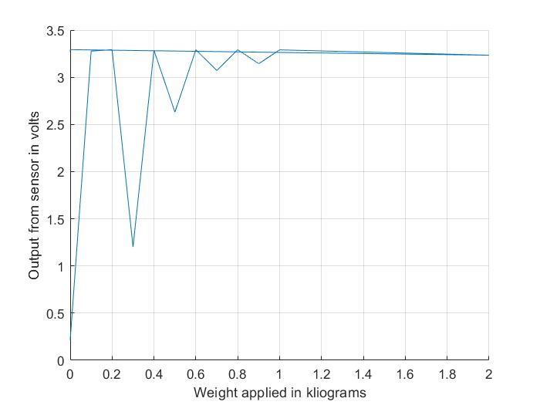
Test of force-sensitive resistor

Slide 18
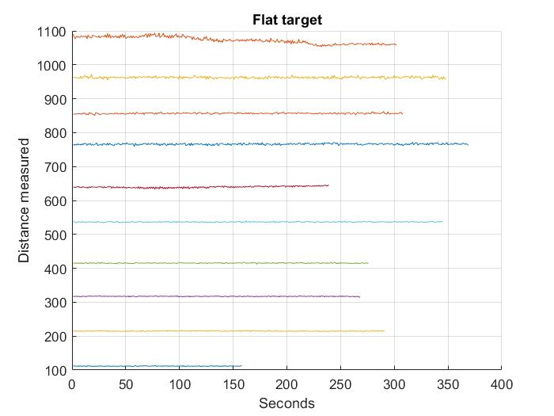
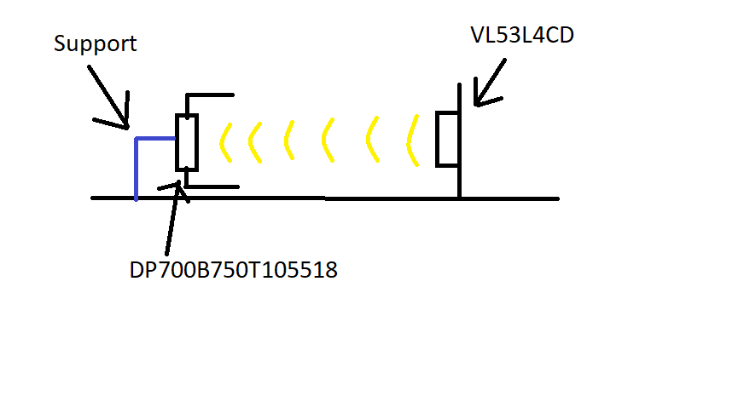
Test of VL53L4CD distance sensor.

Slide 19
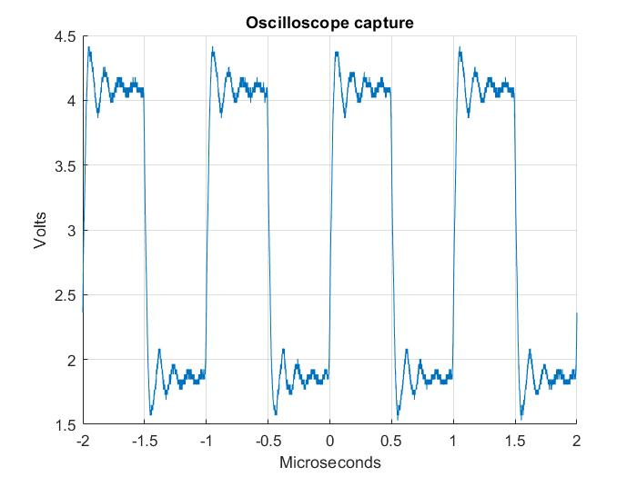
Test of oscilloscope capture.

Slide 20
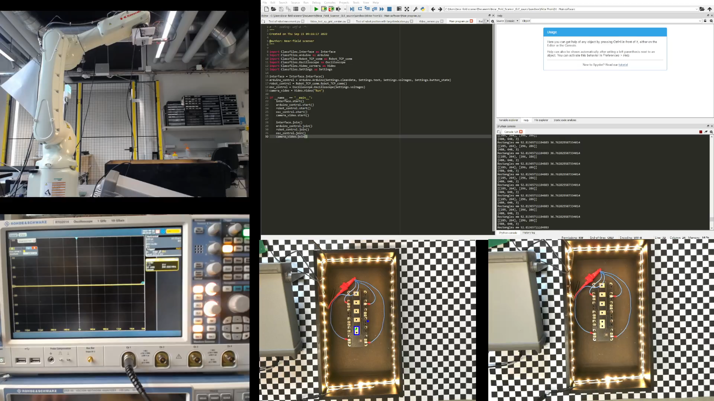
Acceptance test

